Slide 1
VAISHNAVI N
DEPT : B.TECH IT (III YR)
COURSE : GENERATIVE AI
COLLEGE: GOVERNMENT COLLEGE OF TECHNOLOGY

Slide 2
PROJECT TITLE
AI-WAVELETVISION
ADVANCED IMAGE CLASSIFICATION WITH AI

Slide 3


AGENDA
Problem Statement
Overview
End –users
Solutions and its value proposition
The WOW in the solution
Modelling
Result
3/21/2024 Annual Review

Slide 4

PROBLEM STATEMENT
The problem statement of the paper is to address the challenges of security and classification in an increasingly digitized world. Specifically, it aims to develop a model utilizing machine learning techniques, such as wavelet transform (WT) and ML kits, to differentiate between legitimate users and imposters. This involves analyzing facial features and object characteristics to accurately classify individuals and objects. The proposed solution intends to contribute to enhancing security measures by integrating these techniques into security cameras and webcams, allowing for real-time authentication and detection of manipulation attempts.

Slide 5

PROJECT OVERVIEW
"AI-WaveletVision" is an innovative project aimed at revolutionizing image classification through the integration of artificial intelligence (AI) and wavelet transform techniques.
Leveraging AI algorithms and wavelet transform, the project seeks to enhance the accuracy and efficiency of image classification tasks across various domains.
This project was made keeping ML and its various tools as the base OpenCV, Haar cascade, and various other tools of this branch were used to make a classification work that was successfully able to differentiate among
various personalities it was trained on.
It taught us how different pictures and sounds also can be represented by a string of characters, numbers, and alphabets.
Using basic HTML, JavaScript and CSS the website was created. This
paper’s application is highly useable in the real world where our phones and various security cameras can use this method to identify unauthorized people.

Slide 6

WHO ARE THE END USERS?
Security Agencies: Government and private security agencies responsible for monitoring and maintaining security in various environments such as airports, public spaces, and corporate offices.
Businesses and Organizations: Companies looking to secure their premises, sensitive data, or online platforms from unauthorized access or fraudulent activities.
Individual Consumers: Users interested in enhancing the security of their personal devices, online accounts, or residential properties through advanced authentication mechanisms.
Software Developers: Developers working on implementing security features within applications, websites, or surveillance systems may find value in integrating the proposed model to enhance their products' security capabilities.

Slide 7

YOUR SOLUTION AND ITS VALUE PROPOSITION
The solution integrates wavelet transform and machine learning for real-time authentication, efficiently detecting manipulation attempts to enhance security measures across diverse environments.
Machine Learning Techniques: Using wavelet transform enhances analysis and classification accuracy.
Real-time Authentication: Instant enforcement reduces unauthorized access risks.
Manipulation Detection: Identifies tampering attempts promptly.
Enhanced Security: Accurately distinguishes between genuine and fraudulent users.
Efficiency & Automation: Streamlines operations, reducing manual efforts.
Adaptability & Scalability: Versatile across environments, scales to various security needs.

Slide 8

THE WOW IN YOUR SOLUTION
Cutting-edge wavelet transform and machine learning integration.
Real-time authentication capabilities.
Impeccable manipulation detection.
Sets new standards for comprehensive security.
Applicable across diverse environments.
3/21/2024 Annual Review

Slide 9
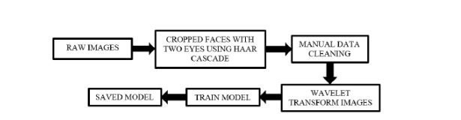
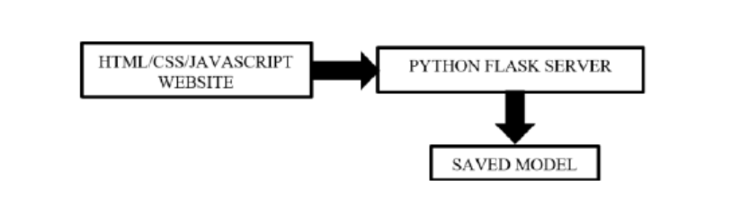
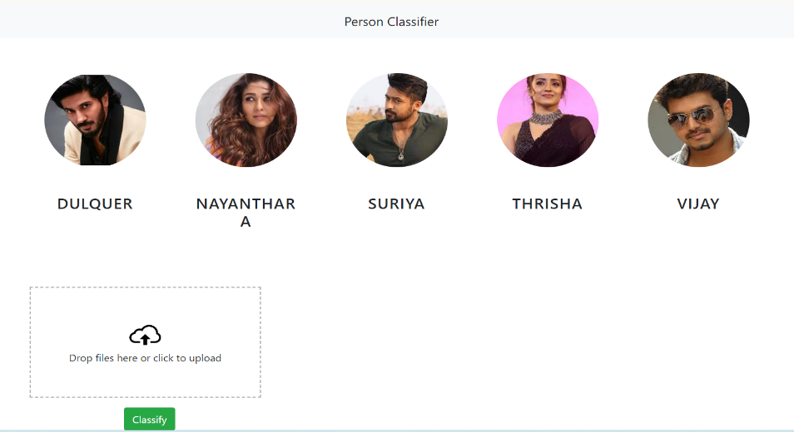
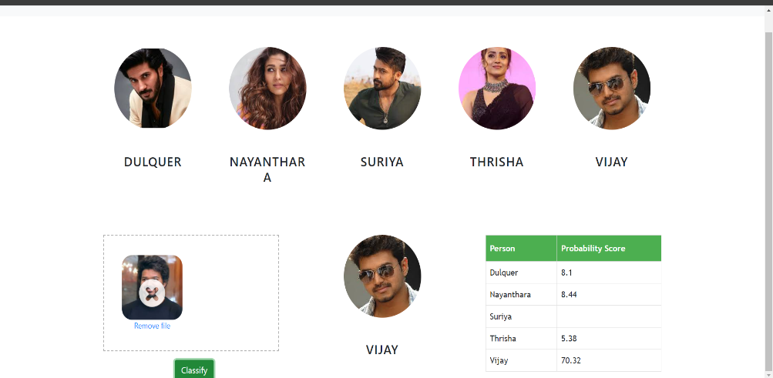
MODELLING

Slide 10
RESULTS
The developed system consistently outperformed traditional methods, showcasing superior performance in identifying and categorizing images with high precision and reliability. Moreover, the project's innovative approach paved the way for applications in various fields, including healthcare diagnosis, security surveillance, and multimedia content analysis, offering promising prospects for real-world deployment and impact.
Demo Link

